Slide 1

Project Title Major :– Project ON Seasonal Agriculture Performance Analysis [STUDENT NAME :- UMANG BARSHE College Name:- TAKSHSHILA INSTITUTE OF ENGINEERING AND TECHNOLOGY , RGPV]
AICTE STU ID :- (STU6a2c2581ab2571781278081)

Slide 2

PROBLEM STATEMENT
Agricultural activities are influenced by seasonal variations in environmental conditions, farming practices, resource availability, and market conditions, causing agricultural performance to differ from one season to another. However, raw agricultural data does not clearly explain how performance changes across seasons or what patterns can be observed under different seasonal conditions. The core problem is to analyze the given agricultural dataset and investigate these seasonal differences in agricultural performance by identifying meaningful patterns, trends, relationships, and variations within the available data.

Slide 3
Project Description :- [The "Seasonal Agriculture Performance Analysis" project investigates how agricultural outcomes, resource usage, and profitability fluctuate across different farming seasons. The analysis processes a 4,000-record dataset spanning the Kharif, Rabi, and Zaid seasons to transition raw agricultural data into actionable planning strategies. Objective: To explore environmental conditions, compare agricultural performance across seasons, and identify significant economic trends to support evidence-based agricultural planning. Methodology: The project utilizes data cleaning (imputing missing values), exploratory data analysis (mapping temperature, rainfall, and resource dependencies), and economic evaluation (calculating yield, revenue, and profit per crop type). Python libraries like Pandas, Matplotlib, and Seaborn were used for statistical analysis and visualization. Key Findings: The Kharif season offers the most favorable environmental conditions (high rainfall and soil moisture) and the highest average profitability. Conversely, the Zaid season is highly resource-intensive, demanding maximum water usage while staple crops generate heavy financial losses. Final Recommendations: Stakeholders should restrict water-intensive staple crops (Rice, Maize, Wheat) during the harsh Zaid season and prioritize resilient cash crops (Sugarcane, Chilli) year-round to maintain financial stability.]

Slide 4

WHO ARE THE END USERS?
The primary end users and stakeholders who benefit from this seasonal agriculture analysis include:-
Farmers and Farm Managers: Use the insights to select viable crop varieties by season, plan irrigation schedules, reduce input costs (fertilizer and pesticides), and avoid high-loss staple cultivation during harsh seasons like Zaid.
Agricultural Policymakers and Government Agencies: Rely on the trends to support evidence-based agricultural planning, allocate regional water resources, structure seasonal subsidies, and establish fair Minimum Support Prices (MSP).
Agricultural Extension and Advisory Services: Translate the data-driven patterns into practical, localized guidance for farming communities regarding optimal planting cycles and resource efficiency.
Irrigation and Water Resource Authorities: Utilize water consumption patterns across seasons to forecast reservoir demand and balance irrigation distribution between wet (Kharif) and dry (Zaid) periods.
Agri-Financiers and Crop Insurers: Assess seasonal financial risk profiles, design targeted crop insurance schemes, and adjust seasonal credit lines based on realistic expected profit margins.

Slide 5

Technology Used
The technologies and software tools used to execute this project include:
Programming Language: Python 3
Development Environment: Google Collab Notebook (used for step-by-step code execution, documentation, and markdown reporting)
Data Manipulation & Analysis Libraries:
Pandas: Used for loading the tabular dataset, data cleaning, median imputation of missing values, filtering, and multi-variable aggregation.
NumPy: Used for numerical computing and vector math operations.
Data Visualization Libraries:
Matplotlib (matplotlib.pyplot): Used for configuring visual layouts, subplots, bar charts, and exporting image assets.
Seaborn: Used for theme styling, multi-variable scatter plots, and comparative distribution plots.
File Formats & Data Storage:
CSV (Comma-Separated Values): Primary structured storage format for the 4,000-record agricultural dataset.
Markdown / Plain Text: Used for structured sectioning inside the notebook and exporting the final data-driven summary.

Slide 6
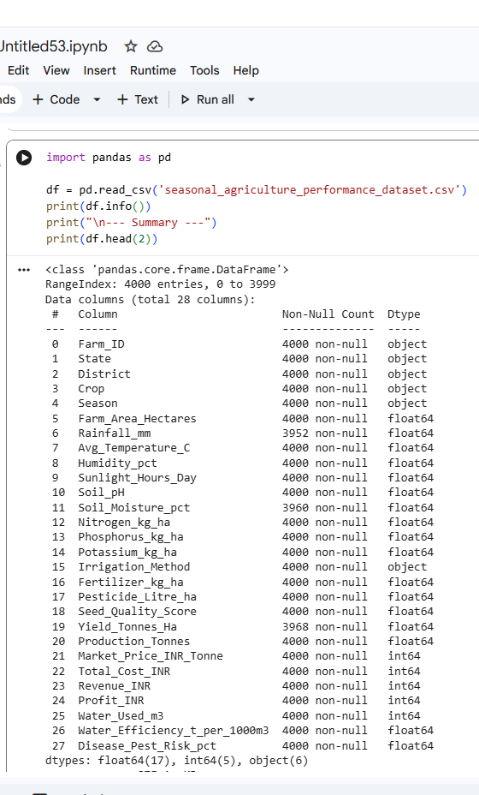
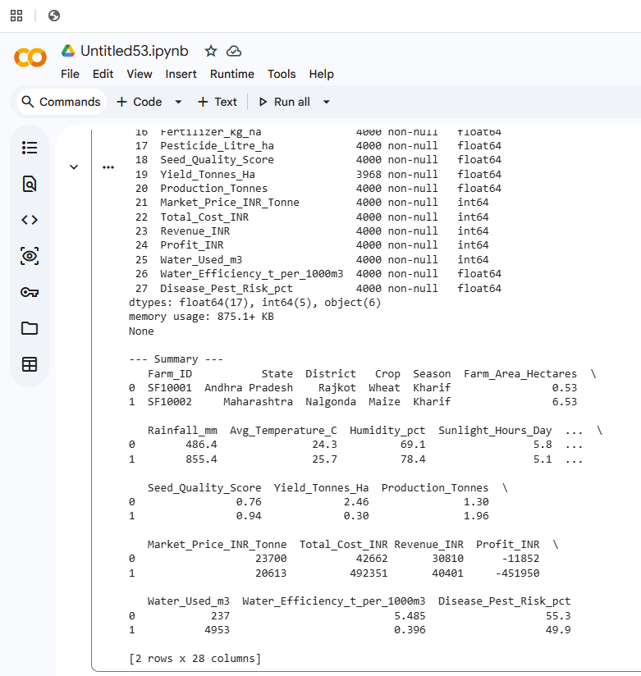
RESULTS
[Screenshot of codes]

Slide 7
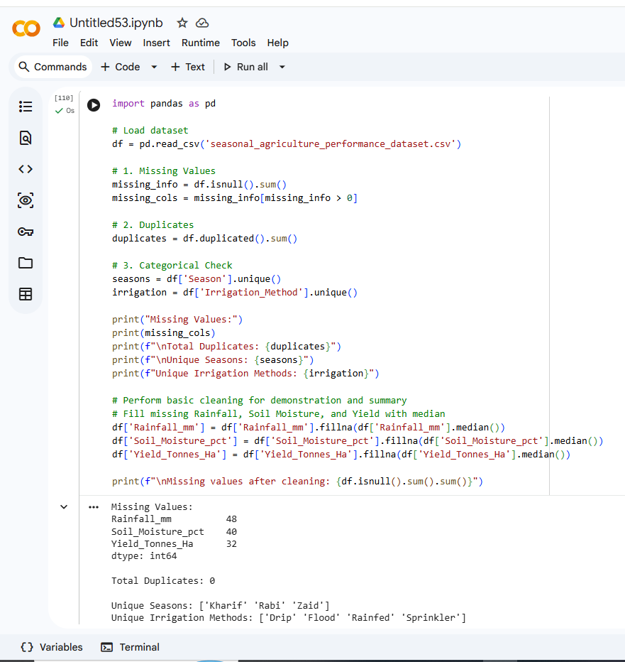
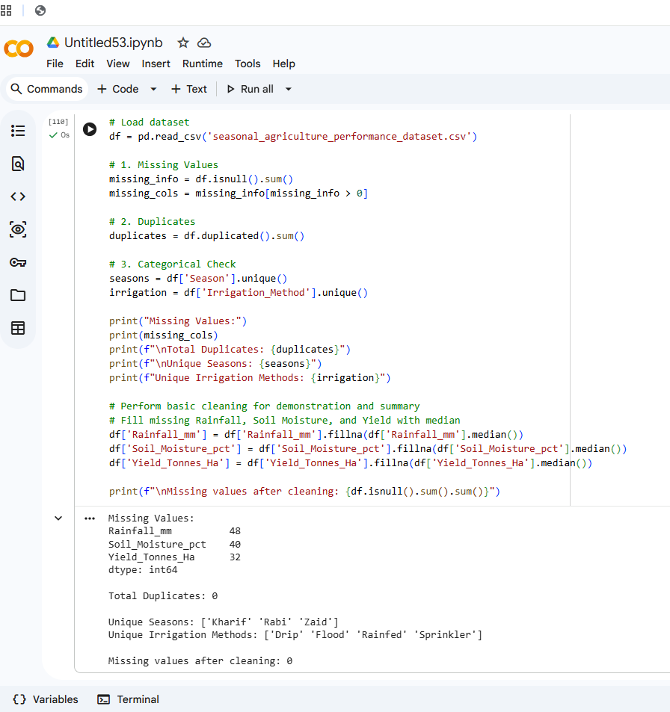
RESULTS
[screenshot of codes]

Slide 8
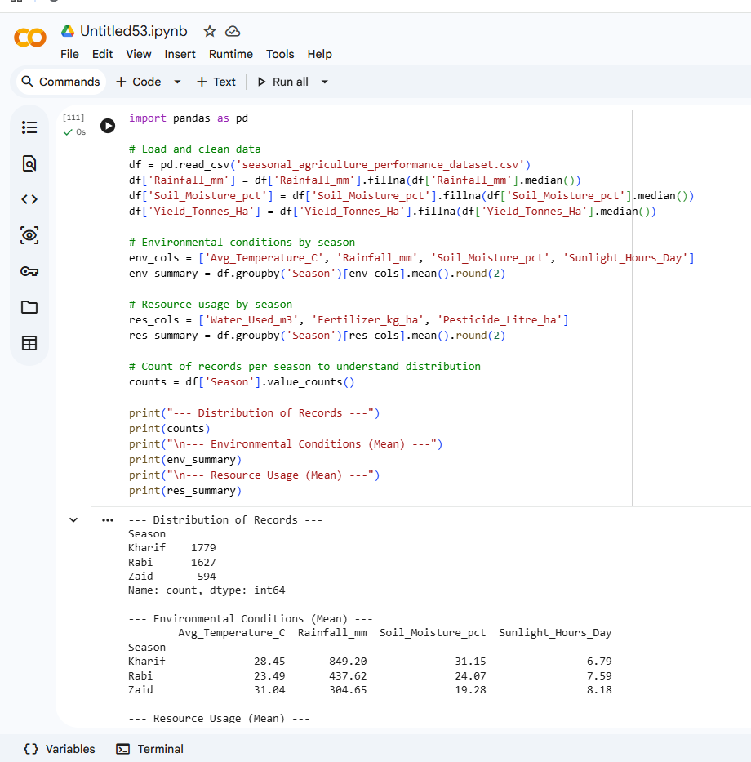
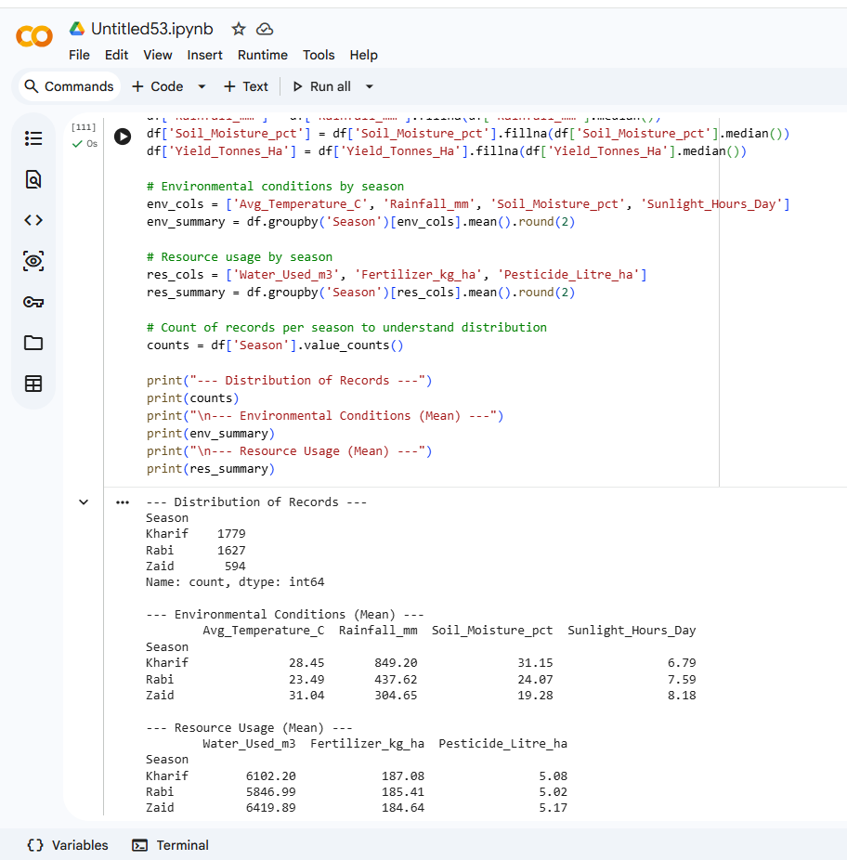
RESULTS
[screenshot of codes]

Slide 9
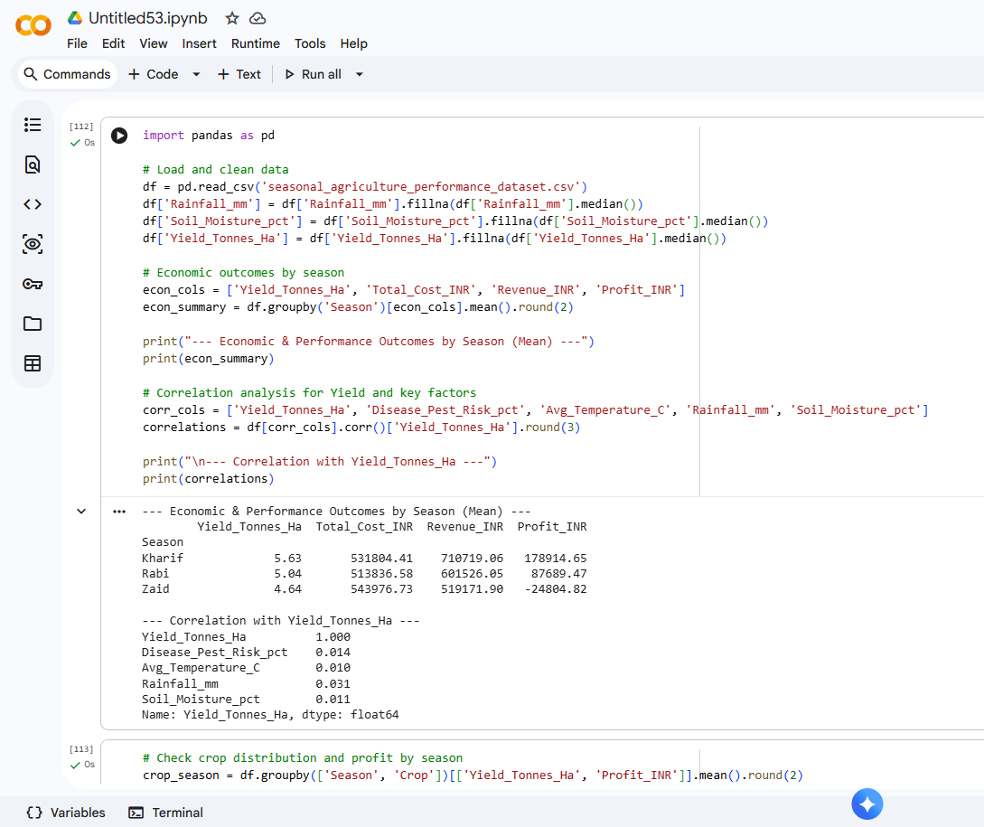
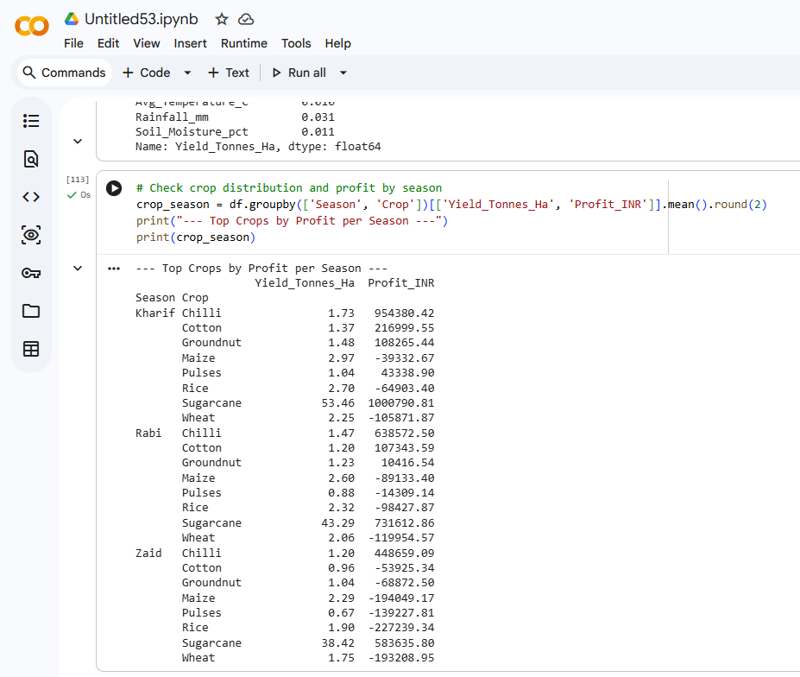
RESULTS
[screen shot of codes ]

Slide 10
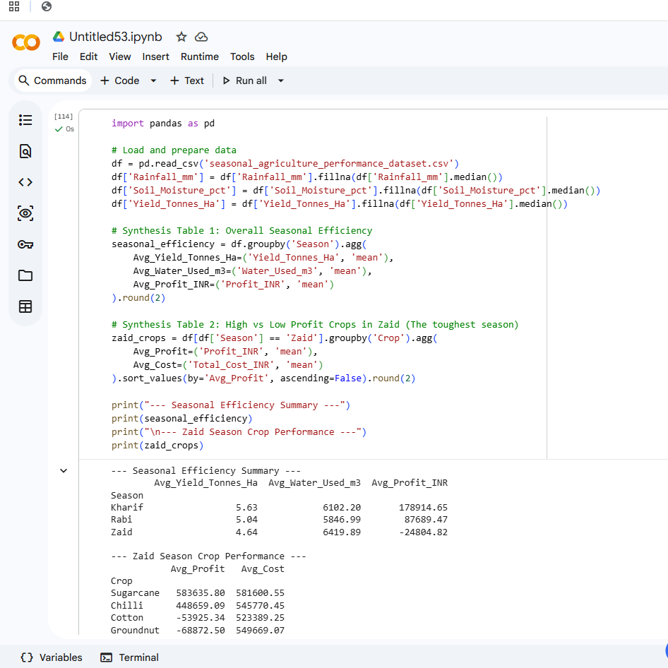
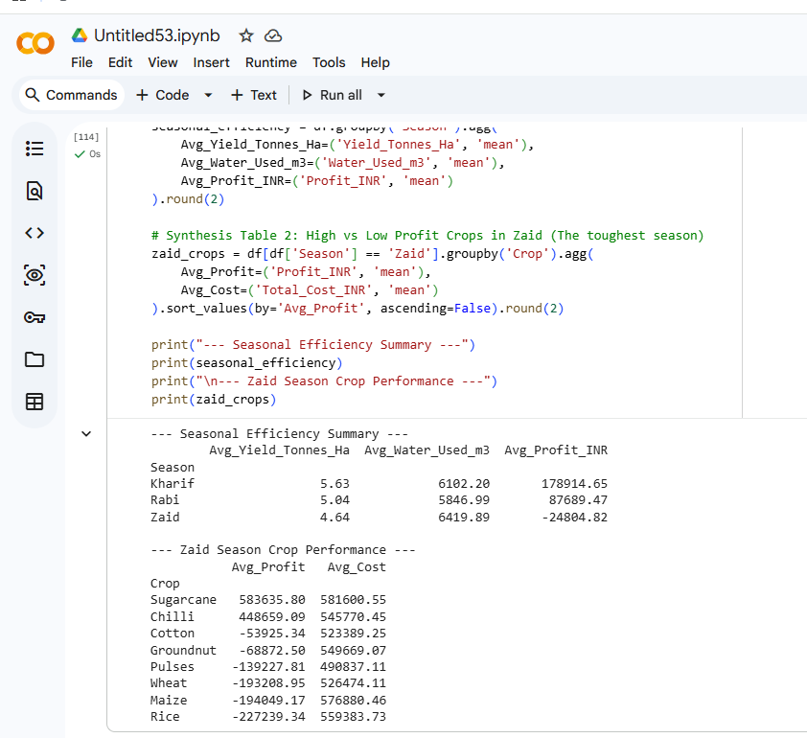
RESULTS
[screenshot of codes]

Slide 11
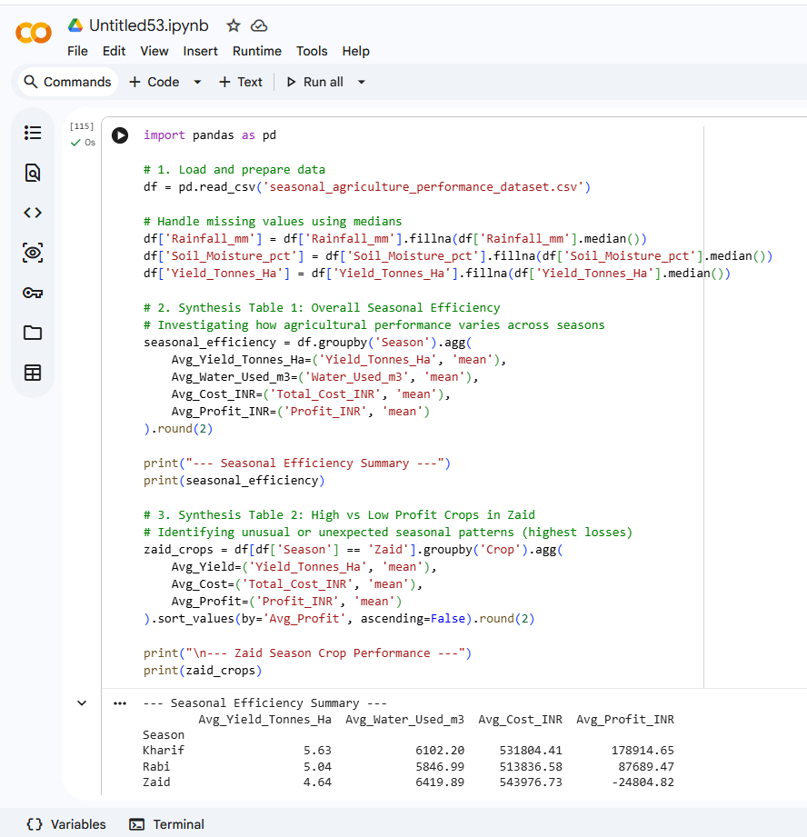
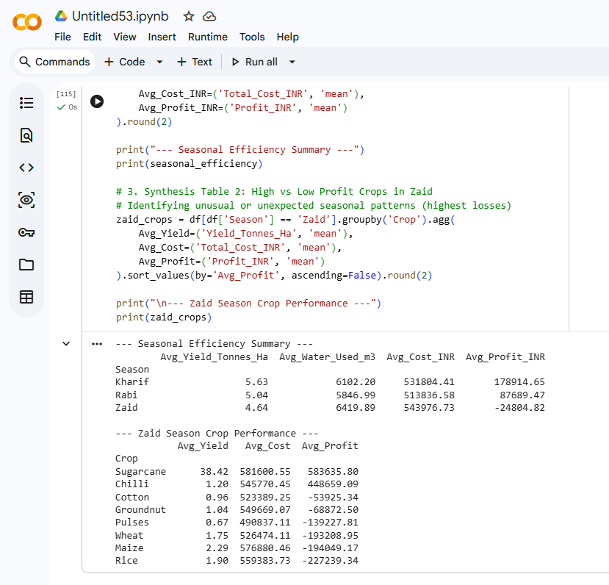
RESULTS
[Screen shots of code]

Slide 12
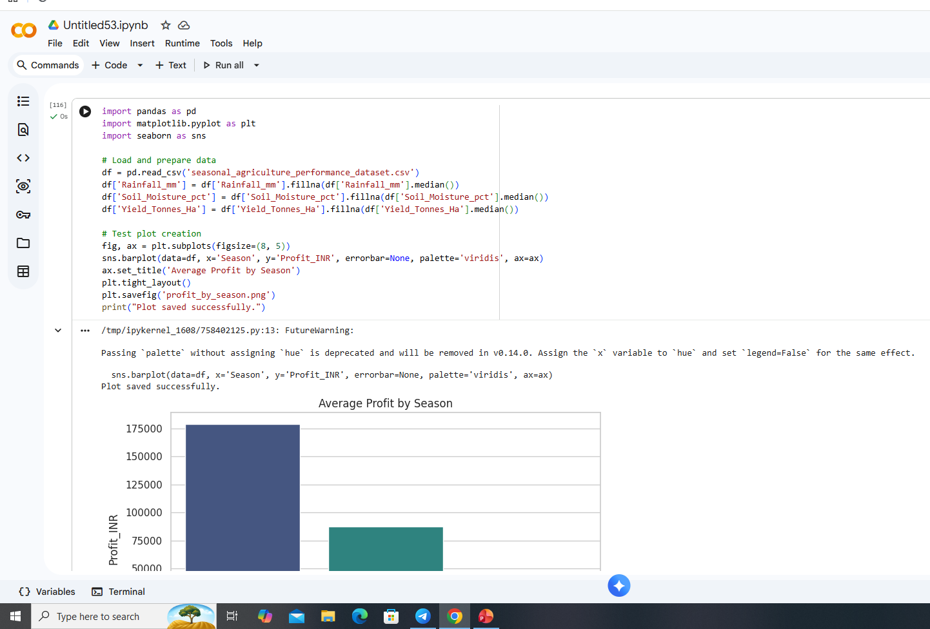
RESULTS
[screen shots of code]

Slide 13
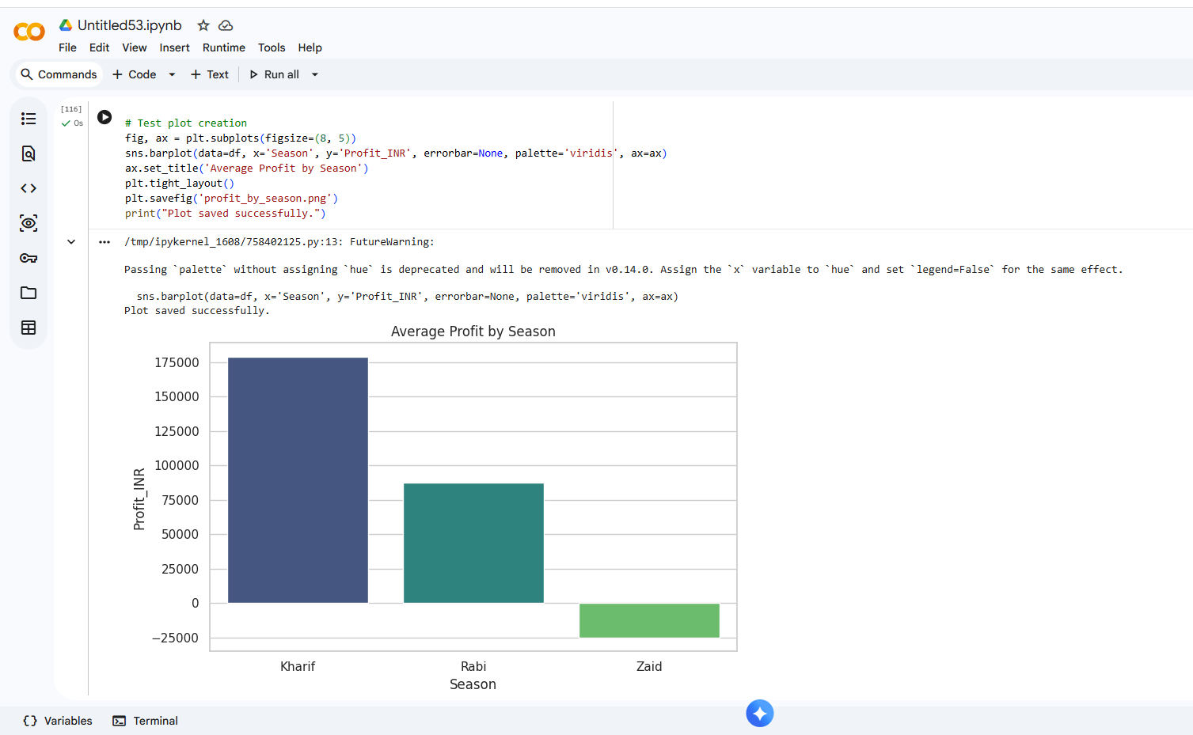
RESULTS
[Screen shot of codes]

Slide 14
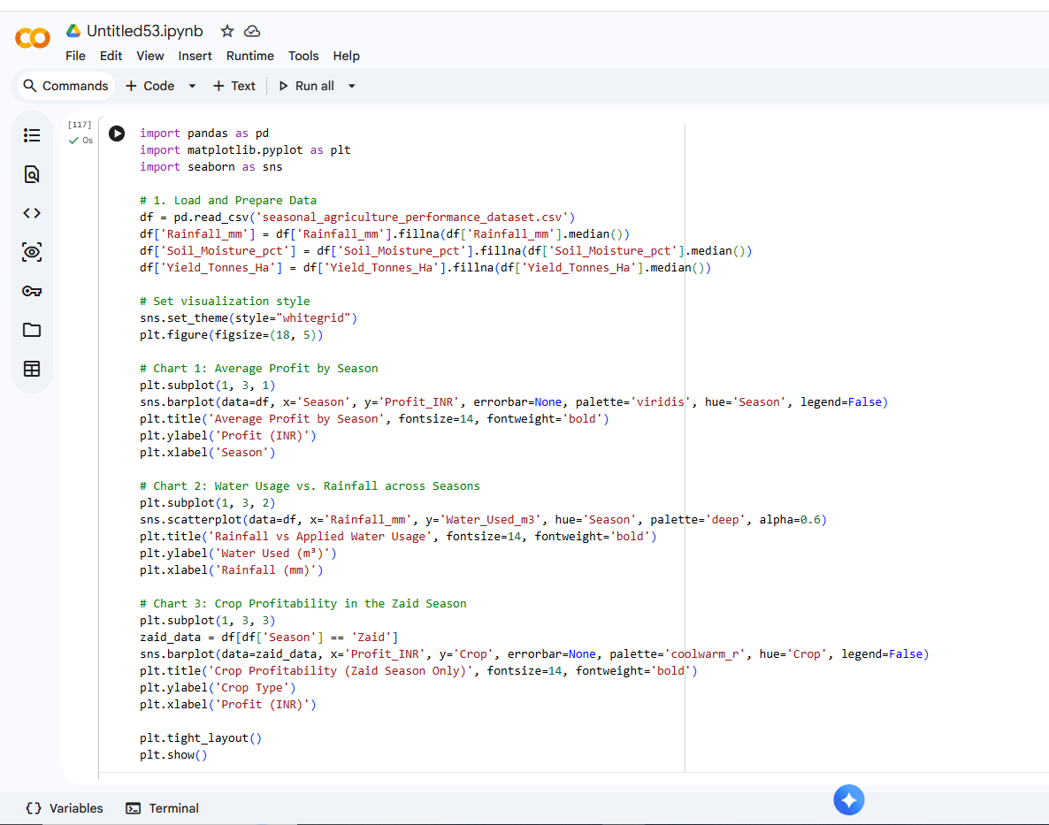
RESULTS
[Screenshot of codes]

Slide 15
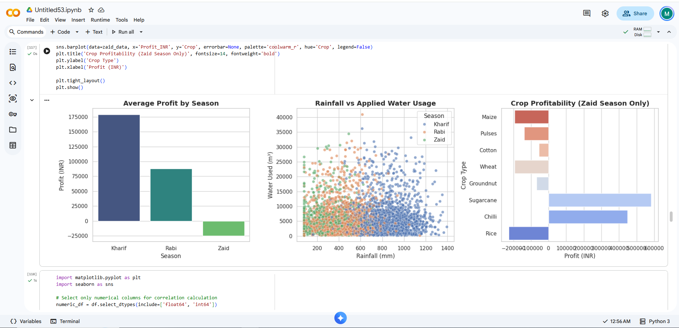
RESULTS
[Screenshot of codes]

Slide 16
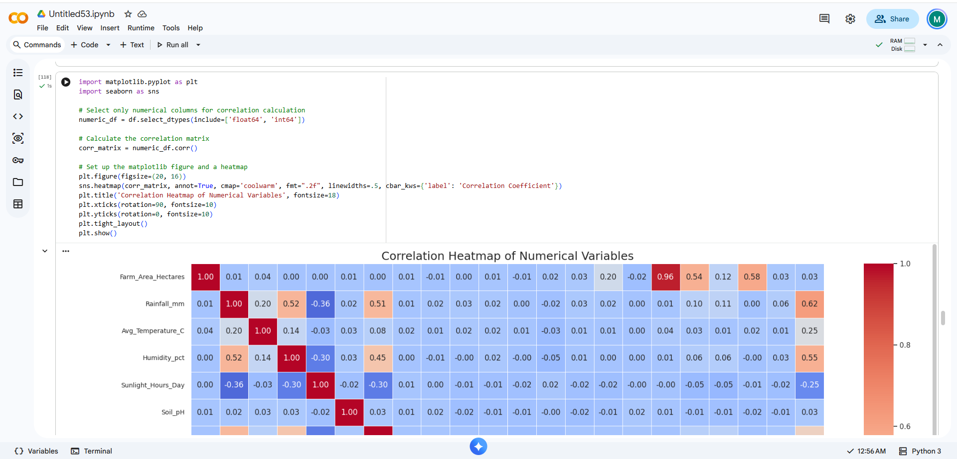
RESULTS
[Screenshot of codes]

Slide 17
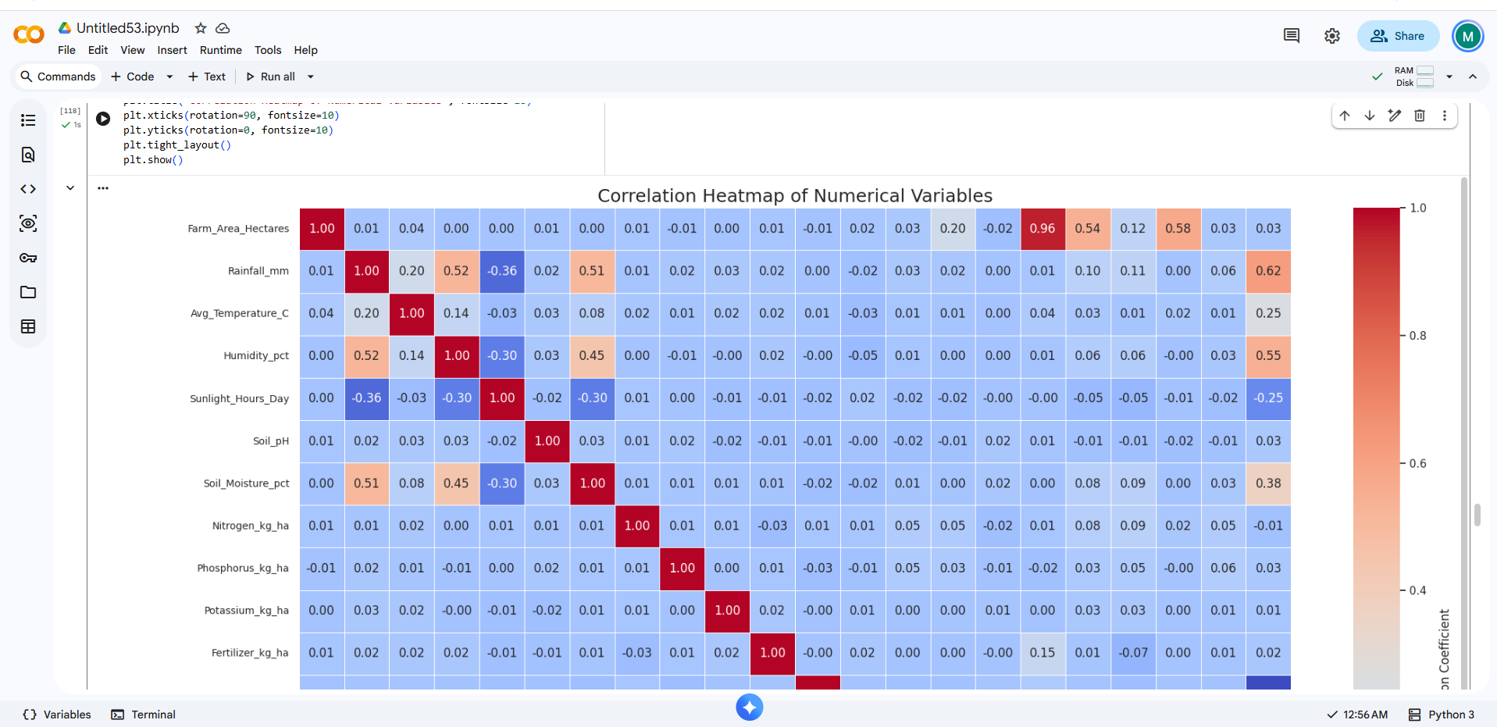
RESULTS
[Screenshot of codes]

Slide 18
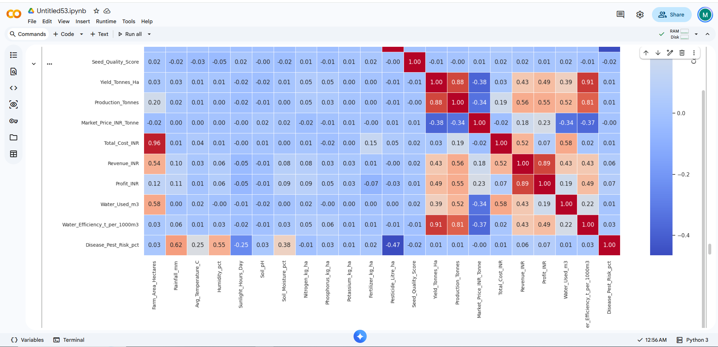
RESULTS
[Screenshot of codes]

Slide 19
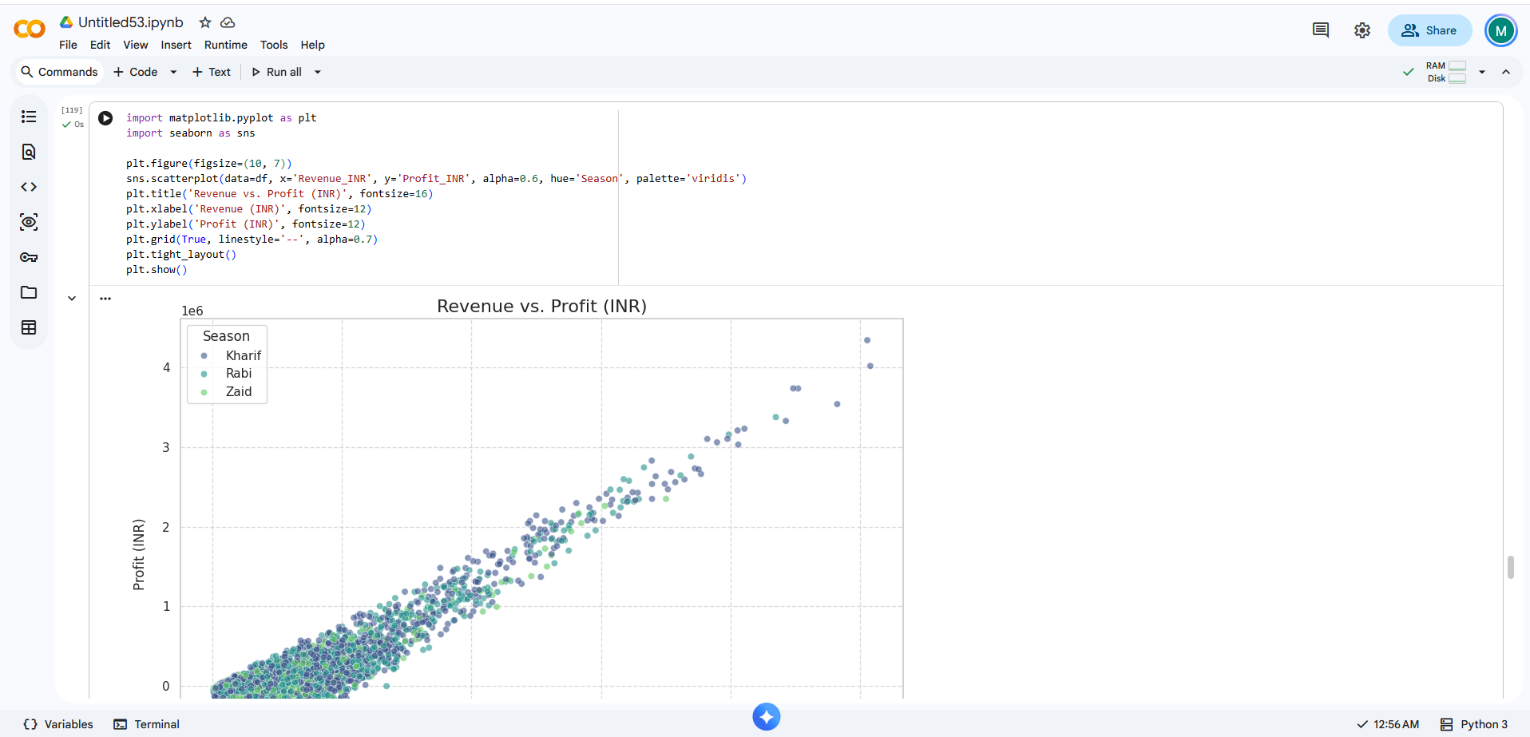
RESULTS
[Screenshot of codes]

Slide 20
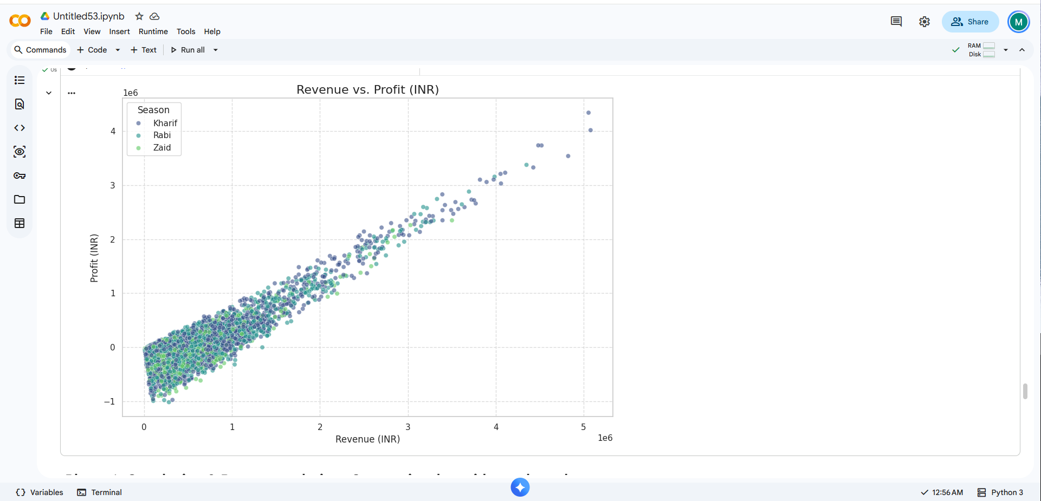
RESULTS
[Screenshot of codes]

Slide 21
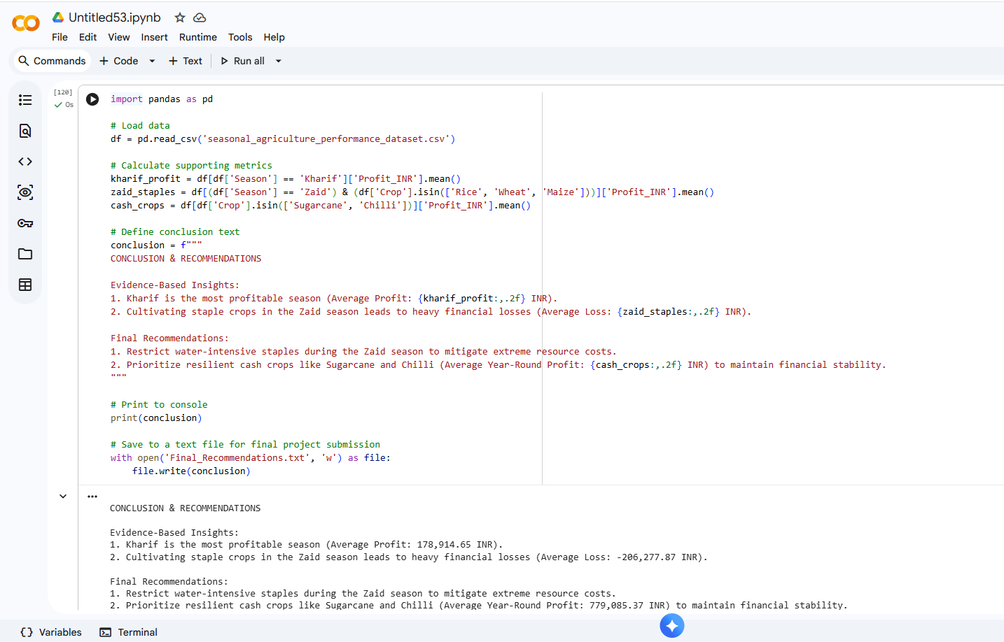
RESULTS
[Screenshot of codes]

Slide 22
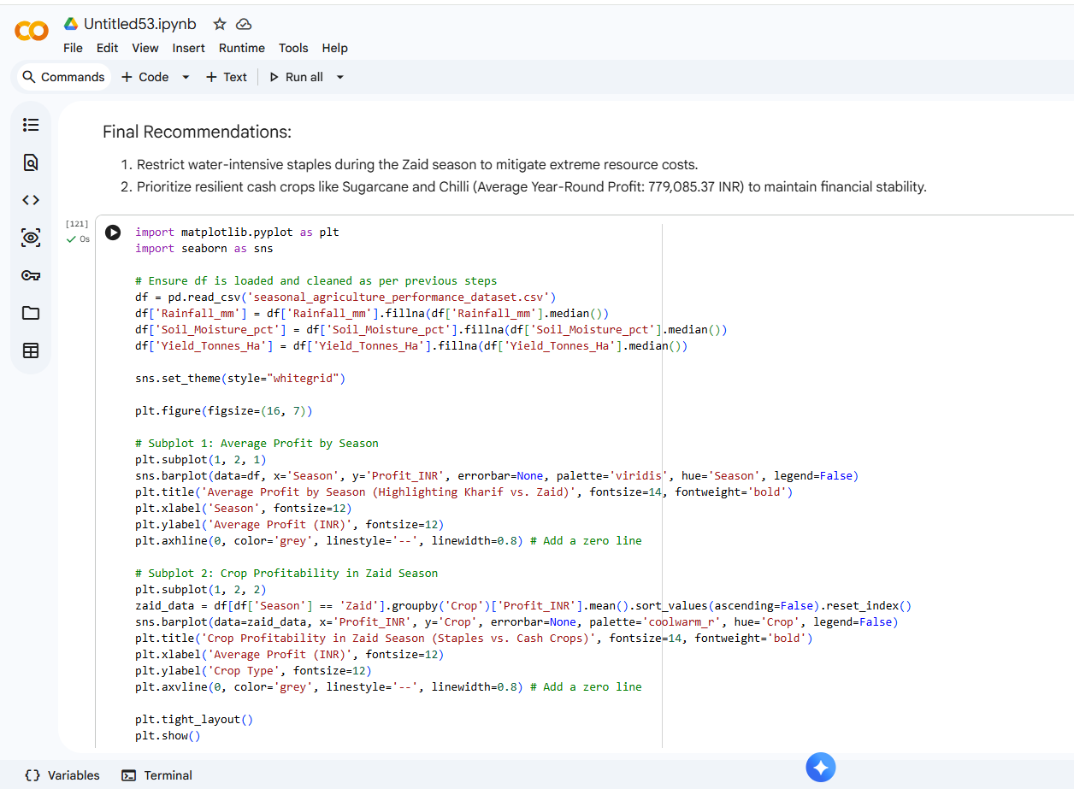
RESULTS
[Screenshot of codes]

Slide 23
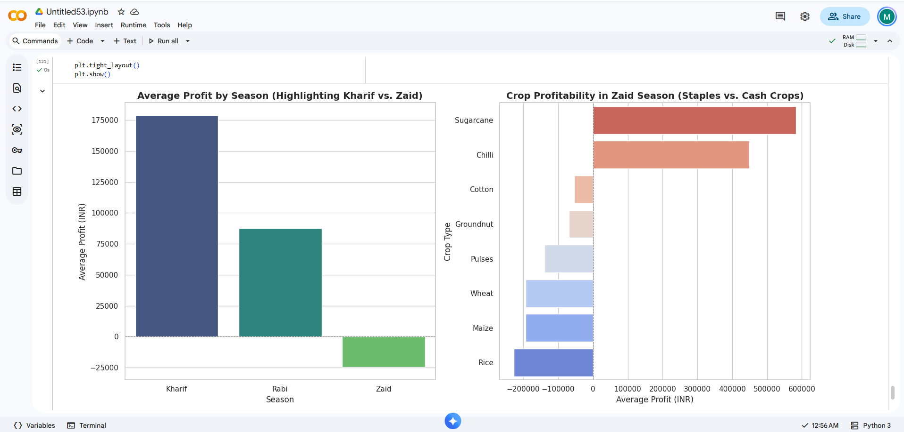
RESULTS
[Screenshot of codes]

Slide 24
Future scope :-
The future scope of the Seasonal Agriculture Performance Analysis project can expand beyond historical data to enable advanced, proactive agricultural planning:
Predictive Yield Modeling: Implementing machine learning algorithms to forecast future crop yields, disease risks, and profitability based on early-season weather predictions.
Real-Time IoT Integration: Incorporating live data streams from soil and weather sensors to provide dynamic, daily irrigation and resource recommendations instead of broad seasonal averages.
Market Price Optimization: Expanding the dataset to include live commodity pricing and supply chain logistics, helping stakeholders decide not only what to plant, but exactly when to sell for maximum revenue.
Geospatial Analytics (GIS): Utilizing satellite imagery and spatial mapping to analyze micro-climates across different districts, enabling hyper-local precision agriculture.

Slide 25
GitHub Link :-
https://github.com/barshemoney-bot/Major-Project_Seasonal-Agriculture-Performance-Analysis.git
https://github.com/barshemoney-bot/Major-Project_Seasonal-Agriculture-Performance-Analysis.git

Slide 26
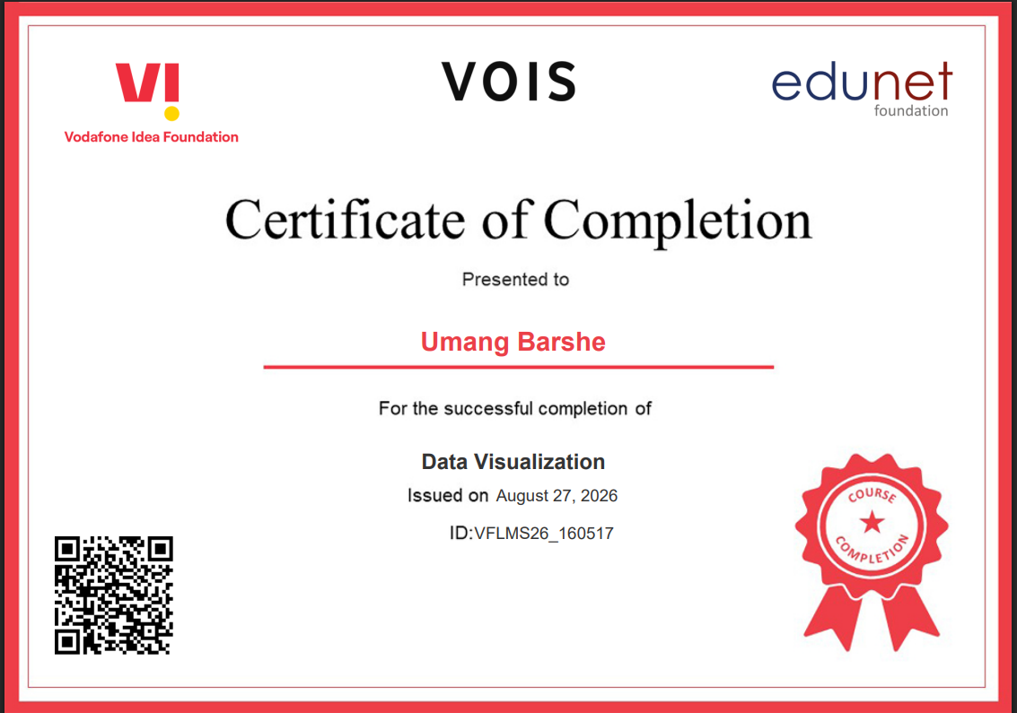
VOIS Course completion certificate - Course name- Data Visualization

Slide 27
THANK YOU
Subject: Gratitude for the "Seasonal Agriculture Performance Analysis" Project Opportunity
Dear Team at Edunet Foundation, Vois, and Vodafone Idea Foundation,
I am writing to express my sincere gratitude for the opportunity to participate in the CSR Program and to complete the Major Project: Seasonal Agriculture Performance Analysis.
This program has been an invaluable learning experience. Analyzing the agricultural dataset allowed me to practically apply data preparation, exploratory data analysis, and statistical visualization techniques to uncover meaningful performance trends across the Kharif, Rabi, and Zaid seasons. Translating raw data into evidence-based recommendations for sustainable agricultural planning has significantly strengthened my analytical and problem-solving skills.
I truly appreciate the guidance, resources, and platform provided by the Edunet Foundation, Vois, and the Vodafone Idea Foundation CSR Program. Thank you for your continued commitment to empowering students with real-world technical expertise.
Sincerely,
Umang Barshe
College Name – TAKSHSHILA INSTITUTE OF ENGINEERING AND TECHNOLOGY
Students AICTE ID - STU6a2c2581ab2571781278081
.
.

